Slide 1

The National University of Computer and Emerging Sciences
Support Vector Machine
Machine Learning for Data Science
Dr. Akhtar Jamil
Department of Computer Science

Slide 2
Goals
Review of Previous Lecture
Today’s Lecture
Support Vector Machine

Slide 3
History of SVM
SVM is a statistical machine learning method introduced in 1992
SVM becomes popular because of its success in handwritten digit recognition
1.1% test error rate for SVM. This is the same as the error rates of a carefully constructed neural network, LeNet
SVM is now regarded as an important example of “kernel methods”, one of the key area in machine learning
Notes:
First introduced in COLT-92 by Boser, Guyon and Vapnik
COLT = computational learning theory
B. Scholkopf et al. ICANN 96. 47-52.

Slide 4
Support Vector Machine
The support vector machine is a binary learning machine
Given a training sample, the support vector machine constructs a hyperplane as the decision surface in such a way that the margin of separation between positive and negative examples is maximized.
Can be extended for nonlinearly separable patterns.

Slide 5
Linear Classifiers
Estimation:
x
f
y^{est}
f(x,w,b) = sign(w. x + b)
denotes +1
denotes -1
w: weight vector
x: data vector
How would you classify this data?

Slide 6
Linear Classifiers
x
f
y^{est}
f(x,w,b) = sign(w. x + b)
denotes +1
denotes -1
How would you classify this data?

Slide 7
Linear Classifiers
x
f
y^{est}
f(x,w,b) = sign(w. x + b)
denotes +1
denotes -1
How would you classify this data?

Slide 8
Linear Classifiers
x
f
y^{est}
f(x,w,b) = sign(w. x + b)
denotes +1
denotes -1
How would you classify this data?

Slide 9
Linear Classifiers
x
f
y^{est}
f(x,w,b) = sign(w. x + b)
denotes +1
denotes -1
Any of these would be fine..
..but which is best?

Slide 10
Classifier Margin
x
f
y^{est}
f(x,w,b) = sign(w. x + b)
denotes +1
denotes -1
Define the margin of a linear classifier as the width that the boundary could be increased by before hitting a datapoint.

Slide 11
Maximum Margin
x
f
y^{est}
f(x,w,b) = sign(w. x + b)
denotes +1
denotes -1
The maximum margin linear classifier is the linear classifier with the, um, maximum margin.
This is the simplest kind of SVM (Called an LSVM)
Linear SVM

Slide 12
Maximum Margin
x
f
y^{est}
f(x,w,b) = sign(w. x + b)
denotes +1
denotes -1
The maximum margin linear classifier is the linear classifier with the, um, maximum margin.
This is the simplest kind of SVM (Called an LSVM)
Support Vectors are those datapoints that the margin pushes up against
Linear SVM

Slide 13
Why Maximum Margin?
f(x,w,b) = sign(w. x + b)
denotes +1
denotes -1
The maximum margin linear classifier is the linear classifier with the, maximum margin for better classification.
This is the simplest kind of SVM (Called an LSVM)
Support Vectors are those datapoints that the margin pushes up against

Slide 14
How to calculate the distance from a point to a line?
denotes +1
denotes -1
wx +b = 0
x
X – Vector
W – Normal Vector
b – Scale Value
W
In our case, w₁*x₁+w₂*x₂+b=0,
thus, w=(w₁,w₂), x=(x₁,x₂)

Slide 15
Estimate the Margin
denotes +1
denotes -1
wx +b = 0
x
X – Vector
W – Normal Vector
b – Scale Value
W
What is the distance expression for a point x to a line wx+b= 0?

Slide 16

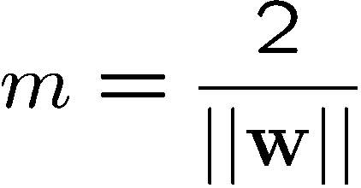



Large-margin Decision Boundary
The decision boundary should be as far away from the data of both classes as possible
We should maximize the margin, m
Class 2
m
Class 1

Slide 17
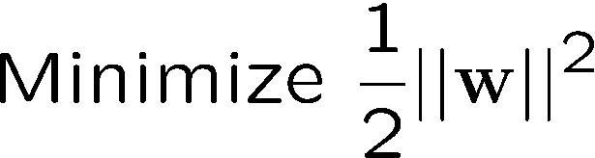
Finding the Decision Boundary
Let {x₁, ..., x_{n}} be our data set and let y_{i} ∈ {1,-1} be the class label of x_{i}
The decision boundary should classify all points correctly ⇒
The decision boundary can be found by solving the following constrained optimization problem

Slide 18
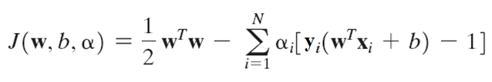
The Dual Problem
Solve the constrained-optimization problem by using the method of Lagrange multipliers
First, we construct the Lagrangian function

Slide 19
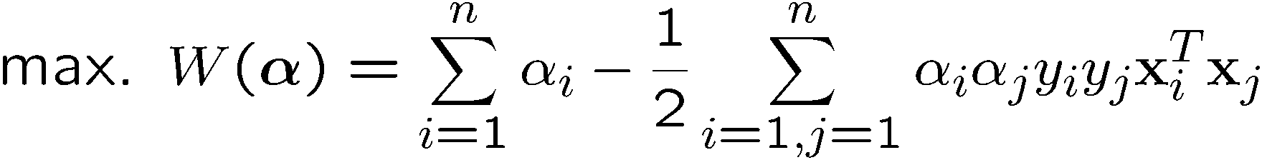
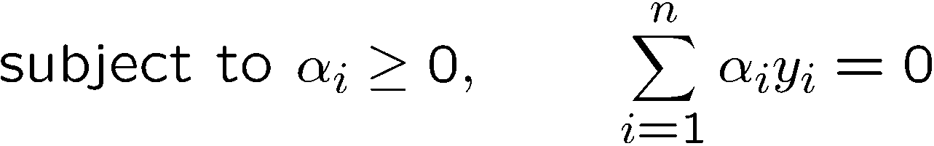
The Dual Problem
The new objective function is in terms of α_{i} only
It is known as the dual problem: if we know w, we know all α_{i}; if we know all α_{i}, we know w
The objective function of the dual problem needs to be maximized

Slide 20
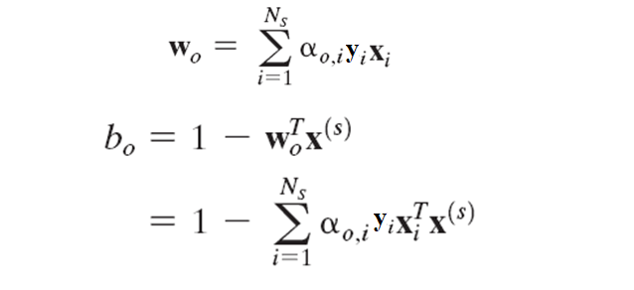
The Dual Problem
Given the training sample {xi, di} find the Lagrange multipliers that maximize the objective function.
Using Lagrange multipliers we can find optimal weights:

Slide 21
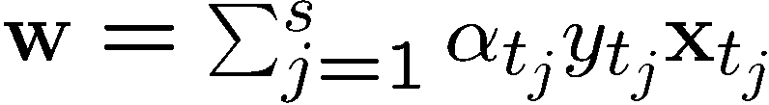
Characteristics of the Solution
Many of the α_{i} are zero
w is a linear combination of a small number of data points
x_{i} with non-zero α_{i} are called support vectors (SV)
The decision boundary is determined only by the SV
Let t_{j} (j=1, ..., s) be the indices of the support vectors. We can write

Slide 22
Characteristics of the Solution
For testing with a new data z
Compute and classify z as class 1 if the sum is positive, and class 2 otherwise

Slide 23




A Geometrical Interpretation
Class 2
α₁₀=0
α₈=0.6
α₇=0
α₂=0
α₅=0
α₁=0.8
α₄=0
α₆=1.4
α₉=0
α₃=0
Class 1
Notes:
So, if change internal points, no effect on the decision boundary

Slide 24








Allowing errors in our solutions
We allow “error” ξ_{i} in classification; it is based on the output of the discriminant function w^{T}x+b
ξ_{i} approximates the number of misclassified samples
Class 2
Class 1

Slide 25
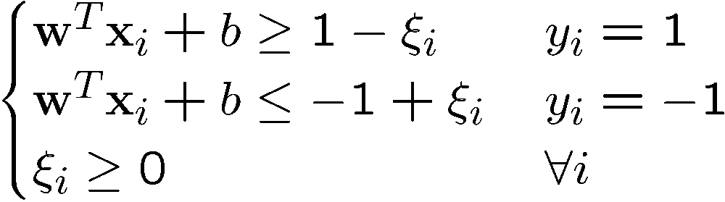

Soft Margin Hyperplane
If we minimize ∑_{i}ξ_{i}, ξ_{i} can be computed by
ξ_{i} are “slack variables” in optimization
Note that ξ_{i}=0 if there is no error for x_{i}
ξ_{i} is an upper bound of the number of errors
We want to minimize
C : tradeoff parameter between error and margin

Slide 26

Soft Margin Hyperplane
If $0<ξ_{i}≤1$ then data point falls inside the boundary but on the correct side of the hyperplane.
If $ξ_{i}>1$ then data point falls on the wrong side of the hyperplane.

Slide 27

Soft Margin Hyperplane
The optimization problem becomes

Slide 28
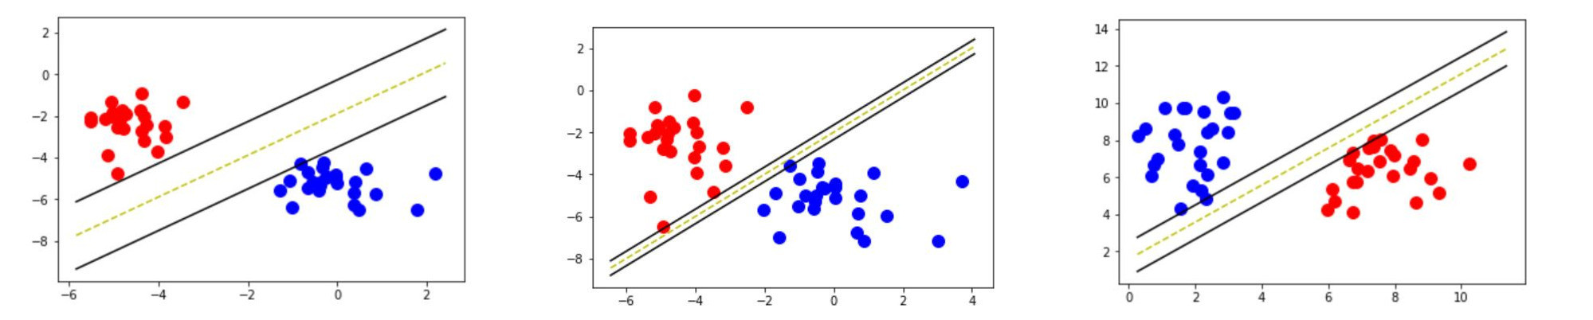
Soft Margin Hyperplane

Slide 29
References
Chapter 6, Neural Networks and Learning Machines, Haykin

Slide 30
Thank You ☺

